Slide 1
Introduction to Tree Data Structure
Data Structures

Slide 2


Slide 3
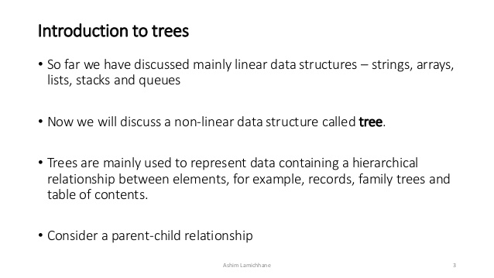

Slide 4
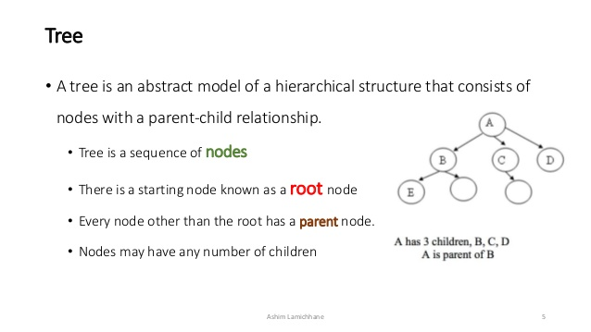

Slide 5
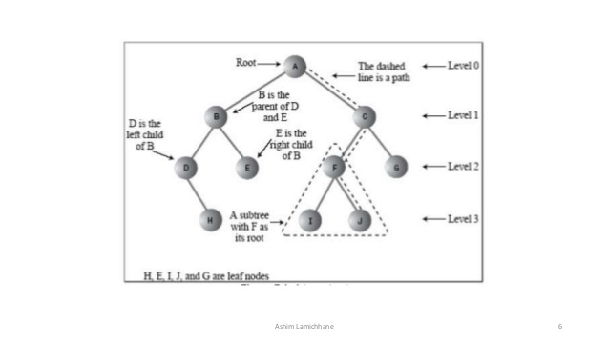

Slide 6
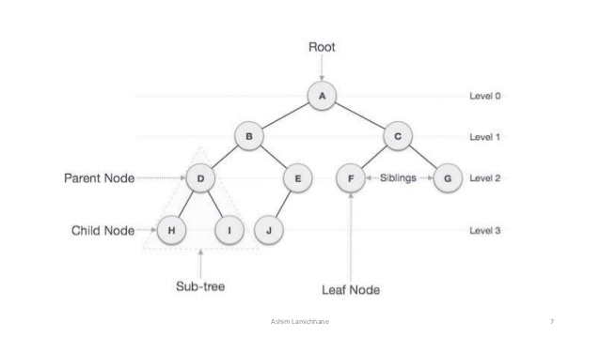

Slide 7
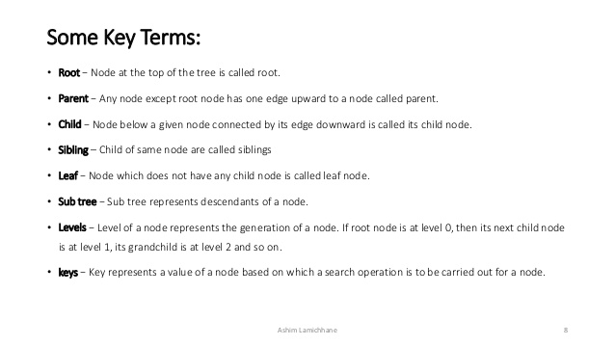

Slide 8
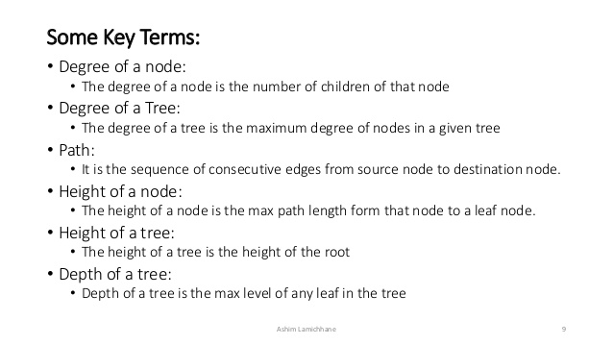

Slide 9
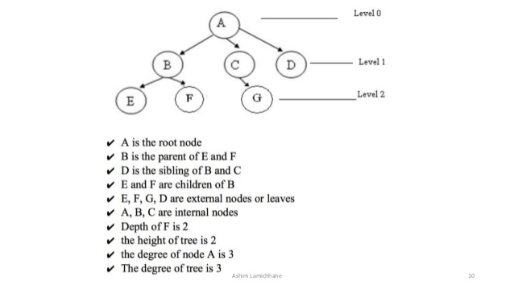

Slide 10
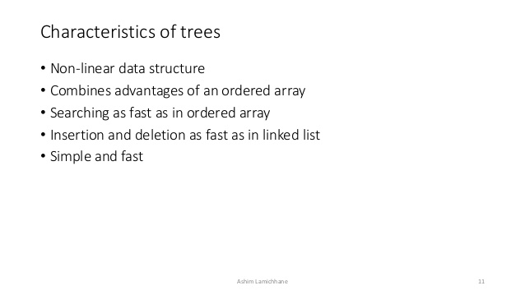

Slide 11


Slide 12
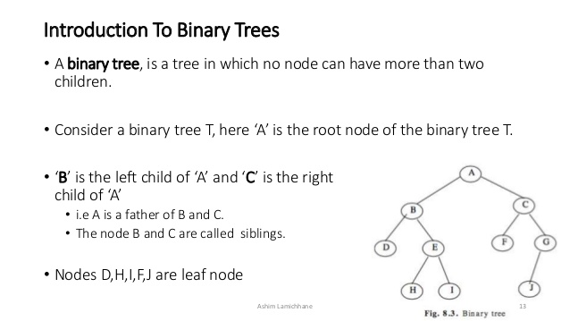

Slide 13
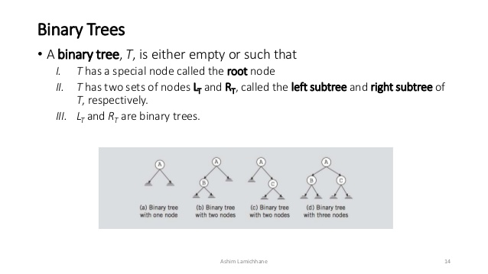

Slide 14
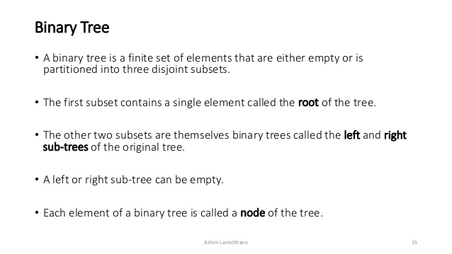

Slide 15
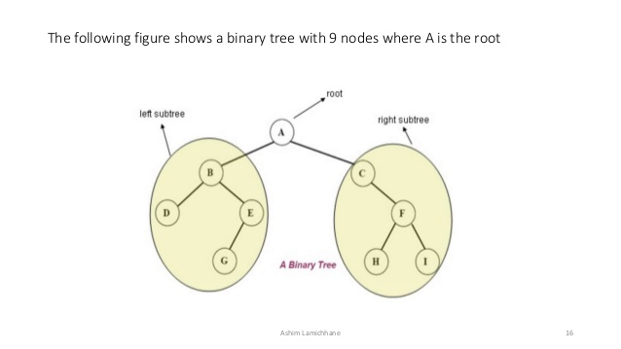

Slide 16
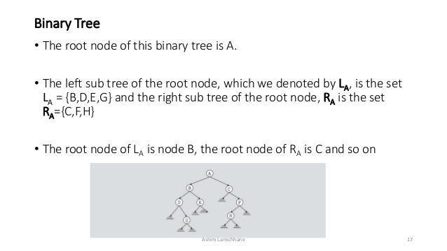

Slide 17
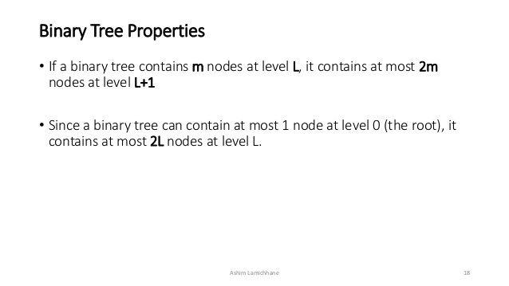

Slide 18
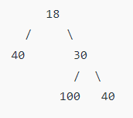
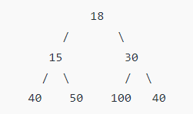
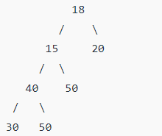
Types of Binary trees
1. Full Binary Tree A Binary Tree is a full binary tree if every node has 0 or 2 children. The following are the examples of a full binary tree. We can also say a full binary tree is a binary tree in which all nodes except leaf nodes have two children.

Slide 19
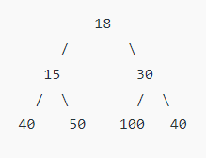
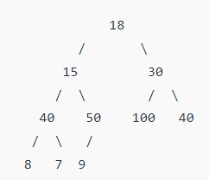
Complete Binary Tree
Complete Binary Tree: A Binary Tree is a Complete Binary Tree if all the levels are completely filled except possibly the last level and the last level has all keys as left as possible

Slide 20
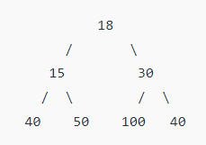
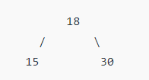
Perfect Binary Tree
Perfect Binary Tree A Binary tree is a Perfect Binary Tree in which all the internal nodes have two children and all leaf nodes are at the same level. The following are the examples of Perfect Binary Trees.

Slide 21
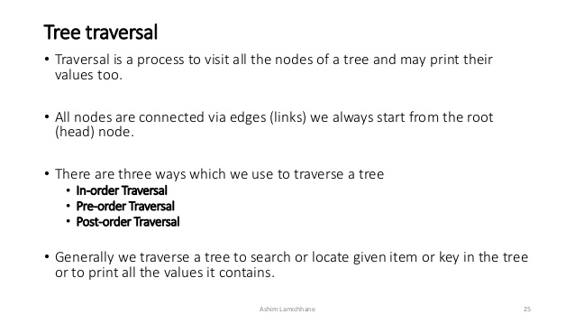

Slide 22


Slide 23
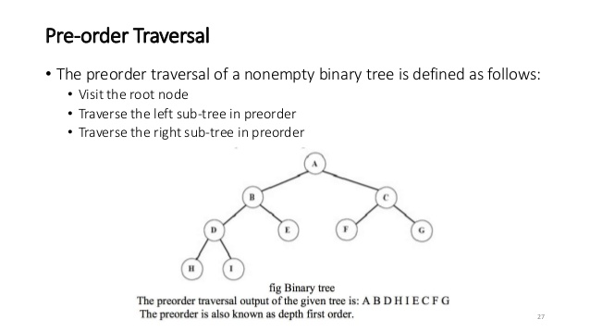

Slide 24
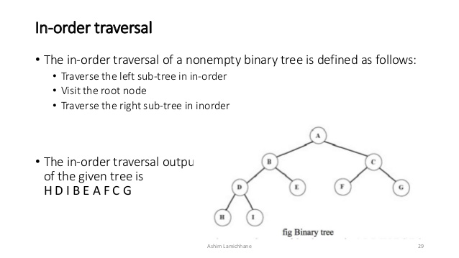

Slide 25
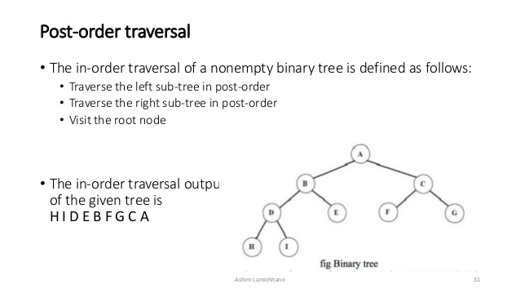

Slide 26
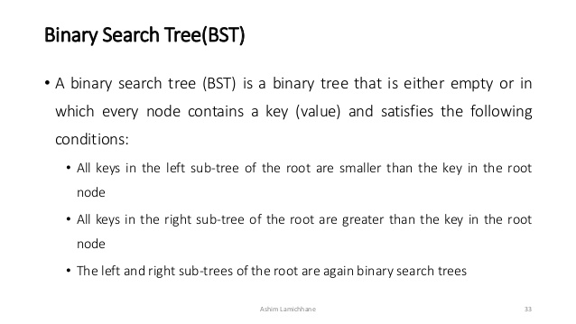

Slide 27
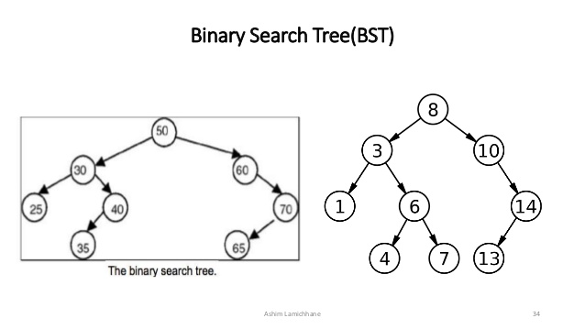

Slide 28
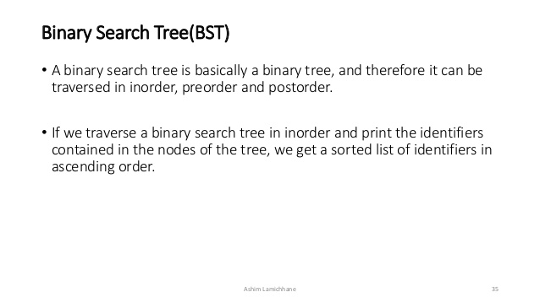

Slide 29
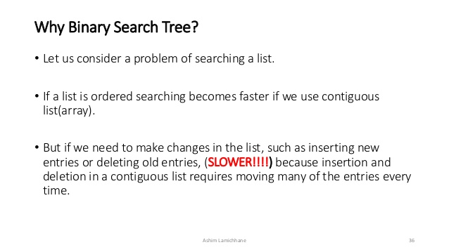

Slide 30
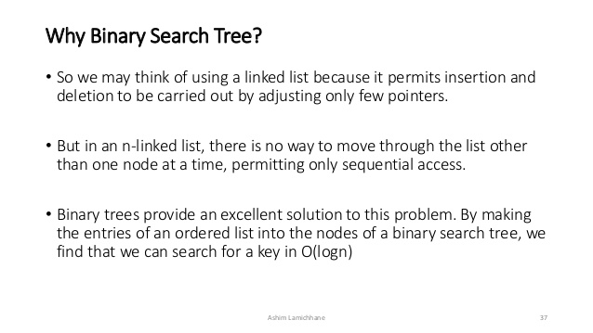

Slide 31
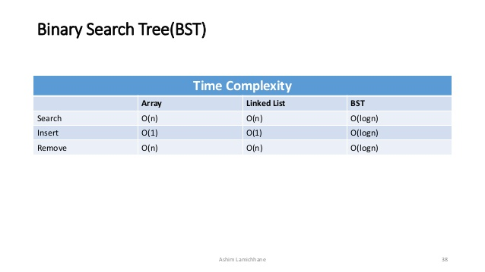

Slide 32
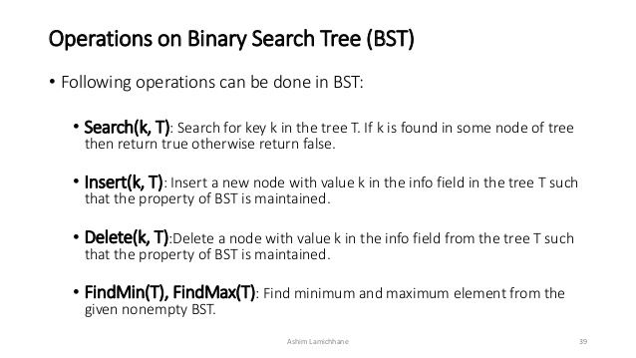

Slide 33
References:
https://www.slideshare.net/AshimLamichhane/tree-data-structure-64560545

